Slide 1
KNN Regression

Slide 2
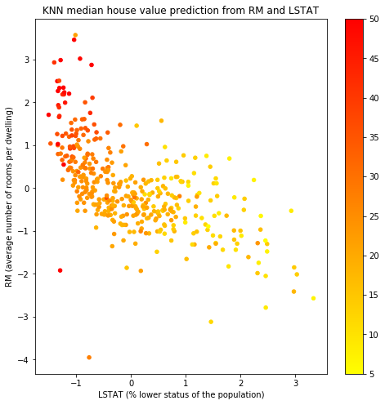
KNN
Neighborhood method
K-neighbors, average for regression
Result is (weighted) average of target value of neighbours
Notes:
Photo: https://www.flickr.com/photos/107442568@N08/12547327134

Slide 3
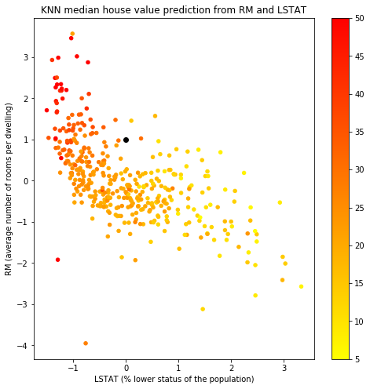
KNN
Neighborhood method
K-neighbors, average for regression
Result is (weighted) average of target value of neighbours
Notes:
Photo: https://www.flickr.com/photos/107442568@N08/12547327134

Slide 4
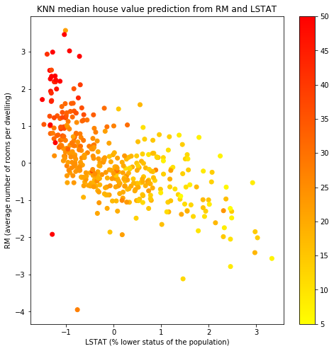
KNN
Neighborhood method
K-neighbors, average for regression
Result is (weighted) average of target value of neighbours
Notes:
Photo: https://www.flickr.com/photos/107442568@N08/12547327134

Slide 5
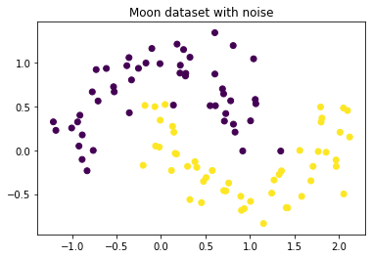
KNN
Neighborhood method
K-neighbors, vote for classification
Ties are resolved by taking the instance that appears first
Looser assumptions than with Log. Reg or SVM
Less work during training, more during prediction
Benefits a lot from dimensionality reduction
Notes:
Photo: https://www.flickr.com/photos/107442568@N08/12547327134

Slide 6
KNN Parameters
k (n_neighbors)
weights - votes from neighbors
distance metric
To determine k nearest neighbours
Notes:
Photo: https://www.flickr.com/photos/107442568@N08/12547327134

Slide 7
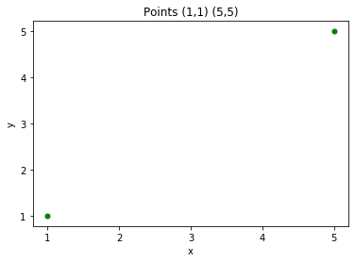
KNN Parameters
k (n_neighbors)
weights - votes from neighbors
distance metric
To determine k nearest neighbours
Notes:
Photo: https://www.flickr.com/photos/107442568@N08/12547327134

Slide 8
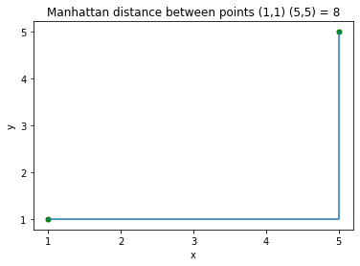

KNN Parameters
k (n_neighbors)
weights - votes from neighbors
distance metric
To determine k nearest neighbours
Manhattan
Notes:
Photo: https://www.flickr.com/photos/107442568@N08/12547327134

Slide 9
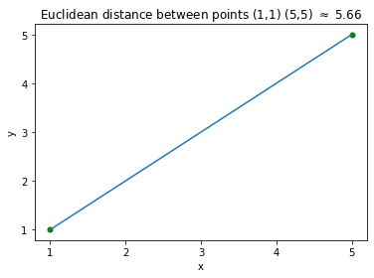

KNN Parameters
k (n_neighbors)
weights - votes from neighbors
distance metric
To determine k nearest neighbours
Manhattan
Euclidean
Notes:
Photo: https://www.flickr.com/photos/107442568@N08/12547327134

Slide 10
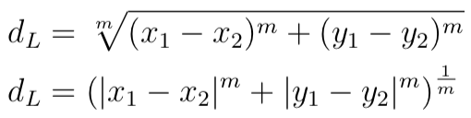
KNN Parameters
k (n_neighbors)
weights - votes from neighbors
distance metric
To determine k nearest neighbours
Manhattan
Euclidean
L_m
Notes:
Photo: https://www.flickr.com/photos/107442568@N08/12547327134

Slide 11
KNN Parameters
k (n_neighbors)
weights - votes from neighbors
distance metric (feature scales!)
To determine k nearest neighbours
Manhattan
Euclidean
L_m
Notes:
Photo: https://www.flickr.com/photos/107442568@N08/12547327134

Slide 12
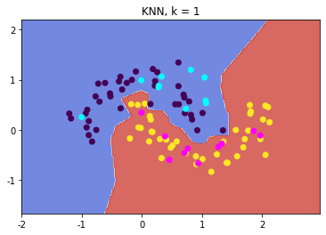
KNN Parameters
k (n_neighbors)
weights
distance metric
To determine k nearest neighbours
Manhattan
Euclidean
L_m
Notes:
Photo: https://www.flickr.com/photos/107442568@N08/12547327134

Slide 13
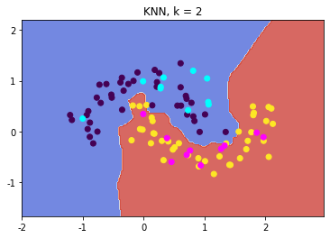
KNN Parameters
k (n_neighbors)
weights
distance metric
To determine k nearest neighbours
Manhattan
Euclidean
L_m
Notes:
Photo: https://www.flickr.com/photos/107442568@N08/12547327134

Slide 14

KNN Parameters
k (n_neighbors)
weights
distance metric
To determine k nearest neighbours
Manhattan
Euclidean
L_m
Notes:
Photo: https://www.flickr.com/photos/107442568@N08/12547327134

Slide 15

KNN Parameters
k (n_neighbors)
weights
distance metric
To determine k nearest neighbours
Manhattan
Euclidean
L_m
Notes:
Photo: https://www.flickr.com/photos/107442568@N08/12547327134

Slide 16

KNN Parameters
k (n_neighbors)
weights
distance metric
To determine k nearest neighbours
Manhattan
Euclidean
L_m
Notes:
Photo: https://www.flickr.com/photos/107442568@N08/12547327134

Slide 17
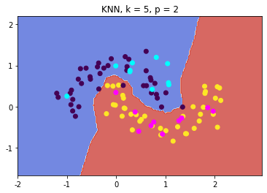
KNN Parameters
k (n_neighbors)
weights
distance metric
To determine k nearest neighbours
Manhattan
Euclidean
L_m (p)
Notes:
Photo: https://www.flickr.com/photos/107442568@N08/12547327134

Slide 18

KNN Parameters
k (n_neighbors)
weights
distance metric
To determine k nearest neighbours
Manhattan
Euclidean
L_m (p)
Notes:
Photo: https://www.flickr.com/photos/107442568@N08/12547327134

Slide 19

KNN Parameters
k (n_neighbors)
weights
distance metric
To determine k nearest neighbours
Manhattan
Euclidean
L_m (p)
Notes:
Photo: https://www.flickr.com/photos/107442568@N08/12547327134

